Slide 1
Computation of Persistent Homology Using the Delaunay-Rips Complex
An efficient family of simplicial complexes
for topological data analysis
Amish Mishra and Francis Motta

Slide 2
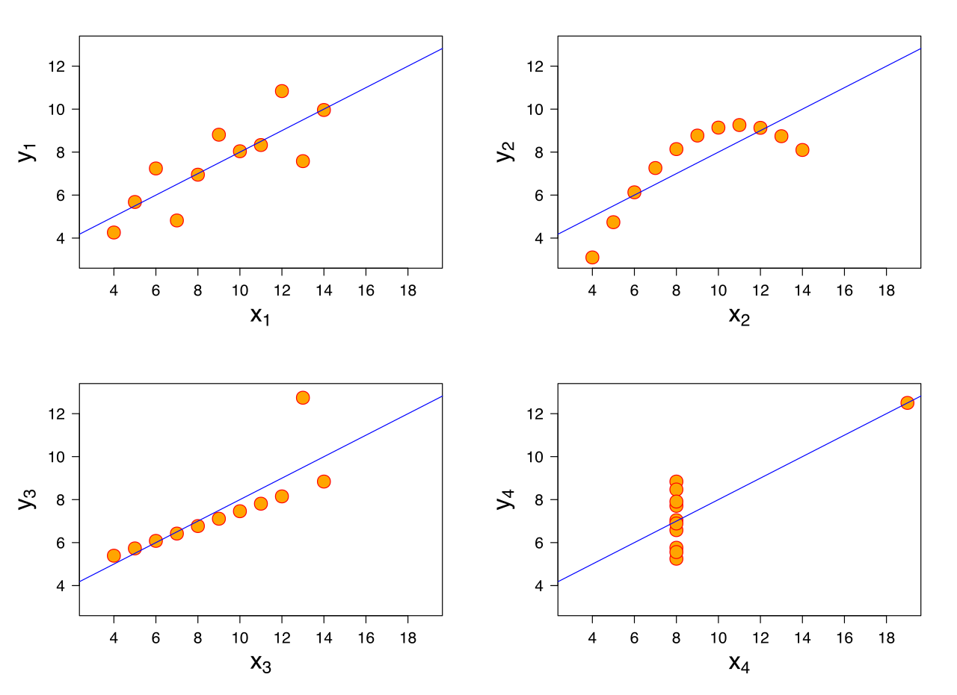
Anscombe’s Quartet
Notes:
Similar mean of x, y, sample variance of x and y, correlation, linear regression, R^2

Slide 3
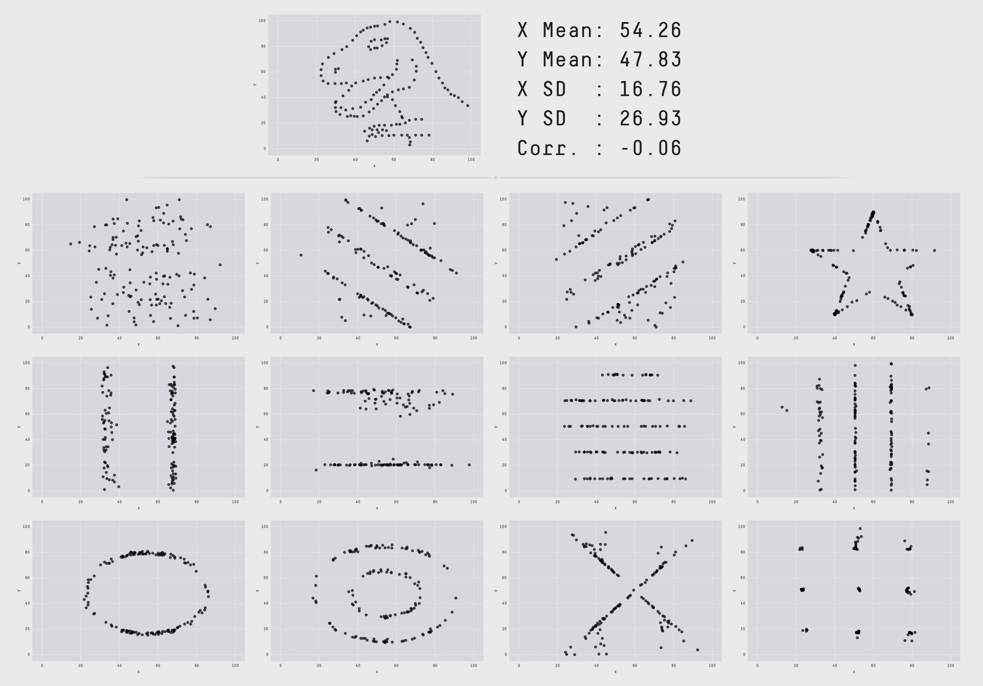
The Datasaurus Dozen
Notes:
https://www.autodesk.com/research/publications/same-stats-different-graphs

Slide 4
Problem:
What to do if visualization is not an option?

Slide 5
TDA (Topological Data Analysis)
Find the shape of the data

Slide 6
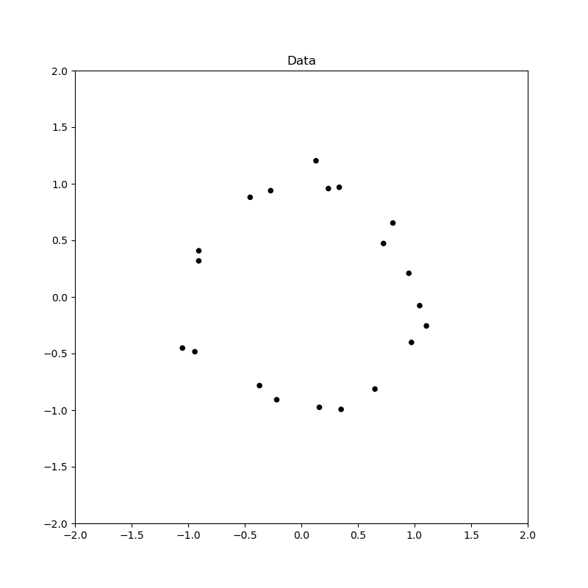
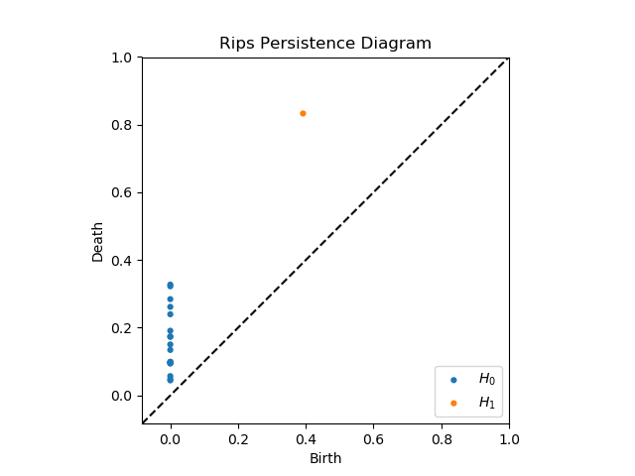
TDA (Topological Data Analysis)

Slide 7
TDA Applications
Protein folding video
Mobile data: https://epjdatascience.springeropen.com/articles/10.1140/epjds/s13688-015-0041-5
Brain arteries:
https://cdr.lib.unc.edu/concern/parent/c534fv18f/file_sets/ft848x10p
Notes:
PersGNN Krishnapriyan

Slide 8
Buzz words
Data/Point cloud
picture

Slide 9
Buzz words
Complex/Topology
Picture

Slide 10
Buzz words
Persistence Diagram/Geometric Features
Picture of PD with complex to show correspondence

Slide 11
Pipeline
Data -> Complex -> Persistence Diagram -> Interpretation

Slide 12
Main question:
Can we do it faster?

Slide 13
Rips

Slide 14
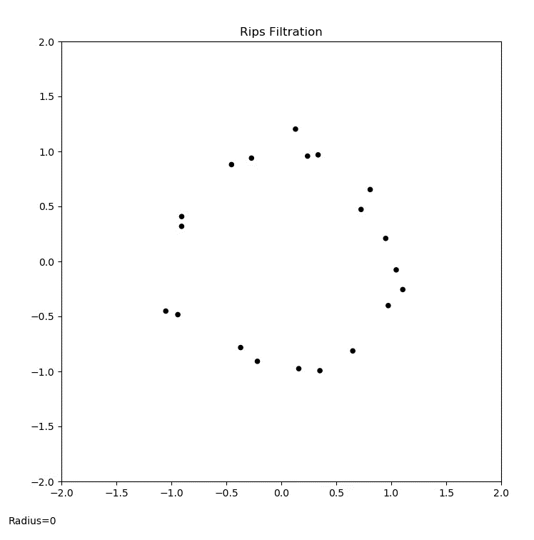
Rips animation

Slide 15
PD Interpretation

Slide 16
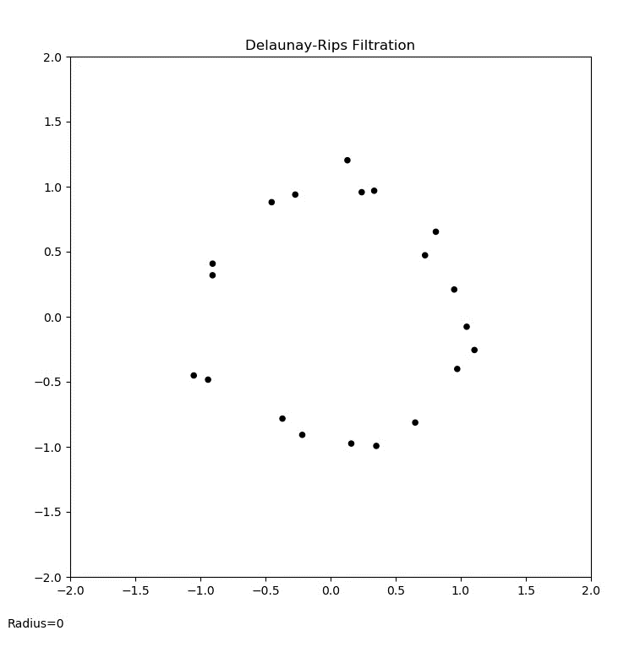
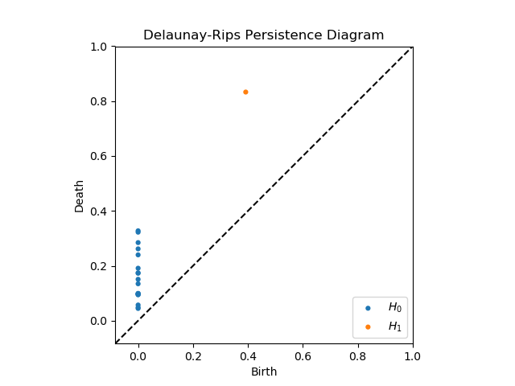
Del-Rips animation

Slide 17

PD Interpretation

Slide 18
Persistence diagram comparison

Slide 19
Run-time comparison

Slide 20
Synthetic Data application

Slide 21
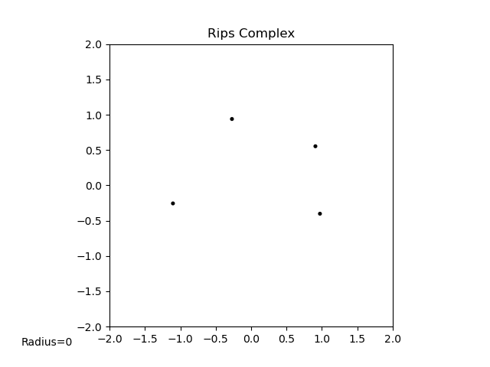
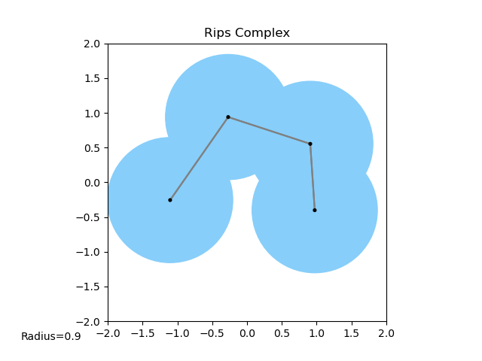
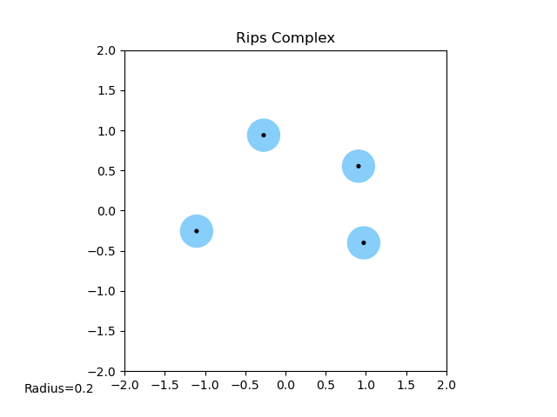
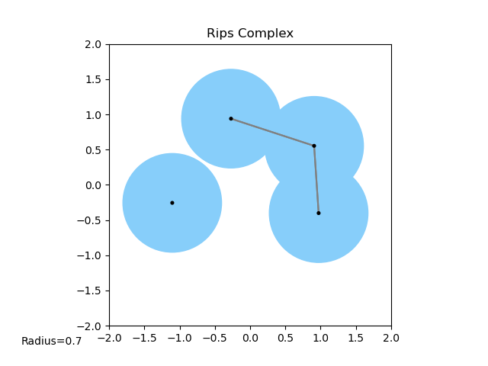
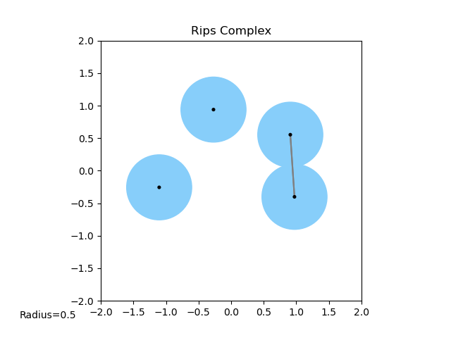
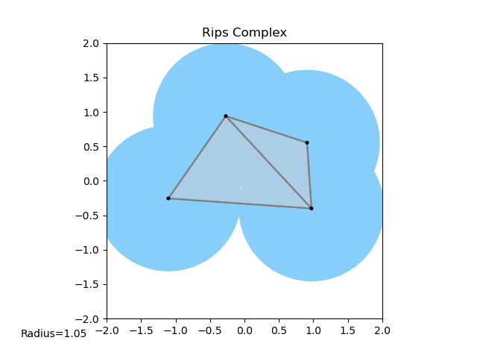
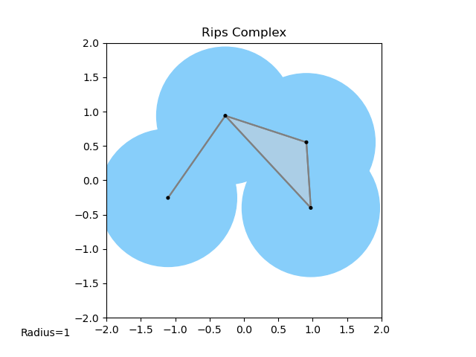
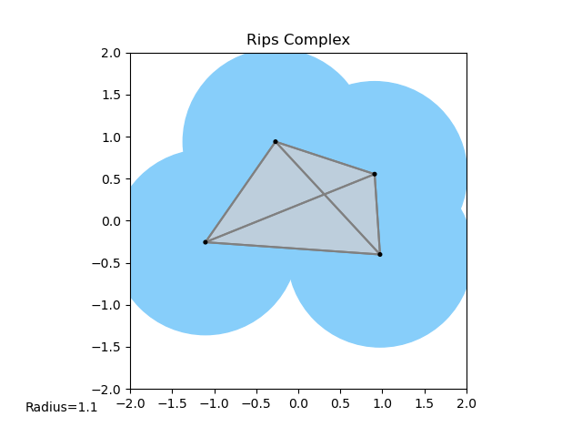
Definition of Rips

Slide 22
Definition of Delaunay Triangulation

Slide 23
Definition of Delaunay-Rips complex

Slide 24
Definition of filtration

Slide 25
Algorithm for building filtration

Slide 26
Question: How stable is this?

Slide 27
Visual 4 pt example of instability

Slide 28
Math behind instability
Proof using the epsilon-delta definition

Slide 29
Conditions that guarantee stability
Theorem
Lemmas
Ideas behind lemma
Visuals of circumcenter moving and causing edge-flips in triangulation
Show when a Delaunay face exists and when it doesn’t
R^2 examples

Slide 30
Maintain Delaunay Triangulation!

Slide 31
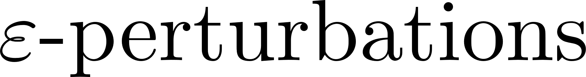
Existing work (Weller)

Slide 32
Apply to real data sets

Slide 33
Applications in ML

Slide 34
Proving stability for other TDA methods

Slide 35
Francis Motta

Slide 36
FAU

Slide 37
JMM

Slide 38
References

